Slide 1
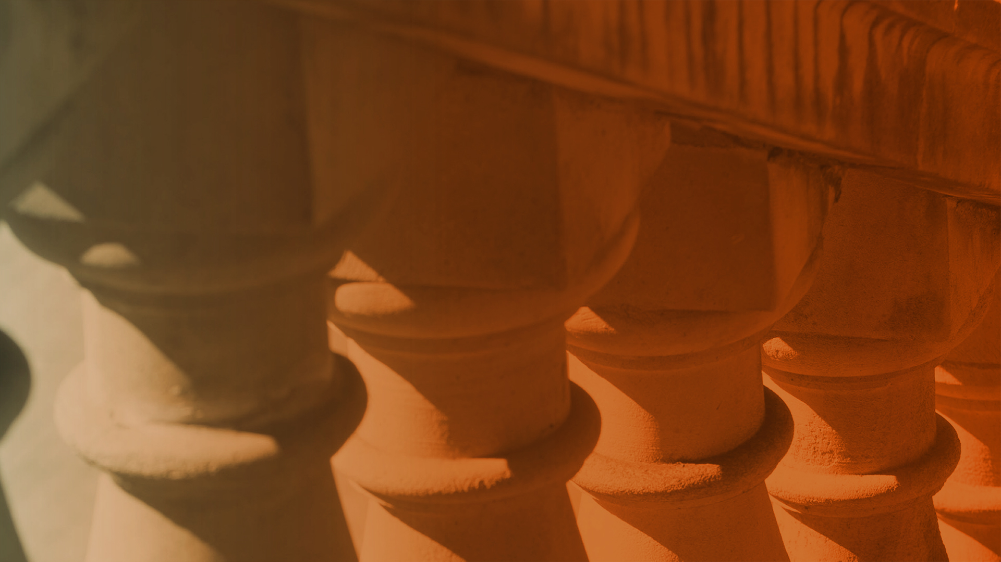

ME397 ASBR HW2 Presentation
Jian Chu, Yang Liu
Team number: 7
Department of Mechanical Engineering,
The University of Texas at Austin

Slide 2
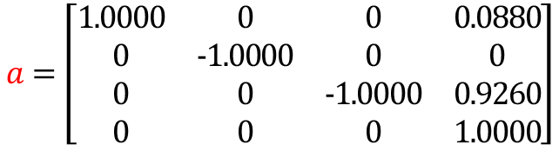
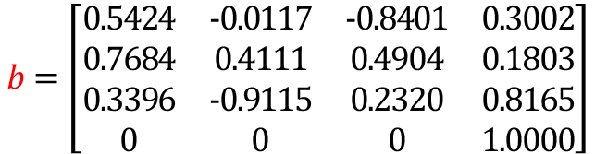
Results of PA1
Input1:
Initial configuration: end-effector position: (x; y; z) = [0.0880; 0; 0.9260 ]; joint angles: theta0=[0; 0; 0; 0; 0; 0; 0]; configuration matrix: a
Desired configuration: end-effector position: (x; y; z) = [0.3002; 0.1803; 0.8165 ]; joint angles: thetad=[1; 1; 1; 1; 1; 1; 1]; configuration matrix: b
Error tolerance: $εw$=0.01; $εv$=0.001;
$$a=\left[\begin{matrix}1.0000 & 0 & 0 & 0.0880 \\ 0 & −1.0000 & 0 & 0 \\ 0 & 0 & −1.0000 & 0.9260 \\ 0 & 0 & 0 & 1.0000\end{matrix}\right]$$
$$b=\left[\begin{matrix}0.5424 & −0.0117 & −0.8401 & 0.3002 \\ 0.7684 & 0.4111 & 0.4904 & 0.1803 \\ 0.3396 & −0.9115 & 0.2320 & 0.8165 \\ 0 & 0 & 0 & 1.0000\end{matrix}\right]$$

Slide 3
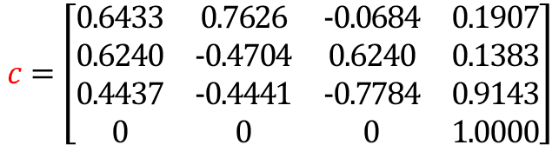
Results of PA1
Input2:
Initial configuration: end-effector position: (x; y; z) = [0.0880; 0; 0.9260 ]; joint angles: theta0=[0; 0; 0; 0; 0; 0; 0]; configuration matrix: a
Desired configuration: end-effector position: (x; y; z) = [0.1907; 0.1383; 0.9143 ]; joint angles: thetad=[0.5; 0.5; 0.5; 0.5; 0.5; 0.5; 0.5]; configuration matrix: c
Error tolerance: $εw$=0.01; $εv$=0.001;
$$a=\left[\begin{matrix}1.0000 & 0 & 0 & 0.0880 \\ 0 & −1.0000 & 0 & 0 \\ 0 & 0 & −1.0000 & 0.9260 \\ 0 & 0 & 0 & 1.0000\end{matrix}\right]$$
$$c=\left[\begin{matrix}0.6433 & 0.7626 & −0.0684 & 0.1907 \\ 0.6240 & −0.4704 & 0.6240 & 0.1383 \\ 0.4437 & −0.4441 & −0.7784 & 0.9143 \\ 0 & 0 & 0 & 1.0000\end{matrix}\right]$$

Slide 4
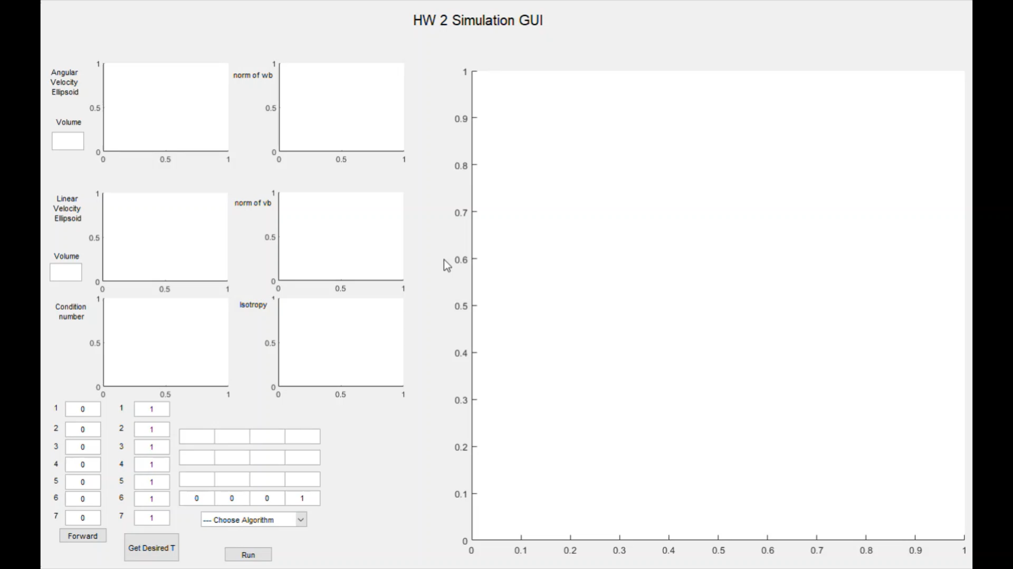
Results of PA1.h
Output1: inverse kinematics algorithm

Slide 5
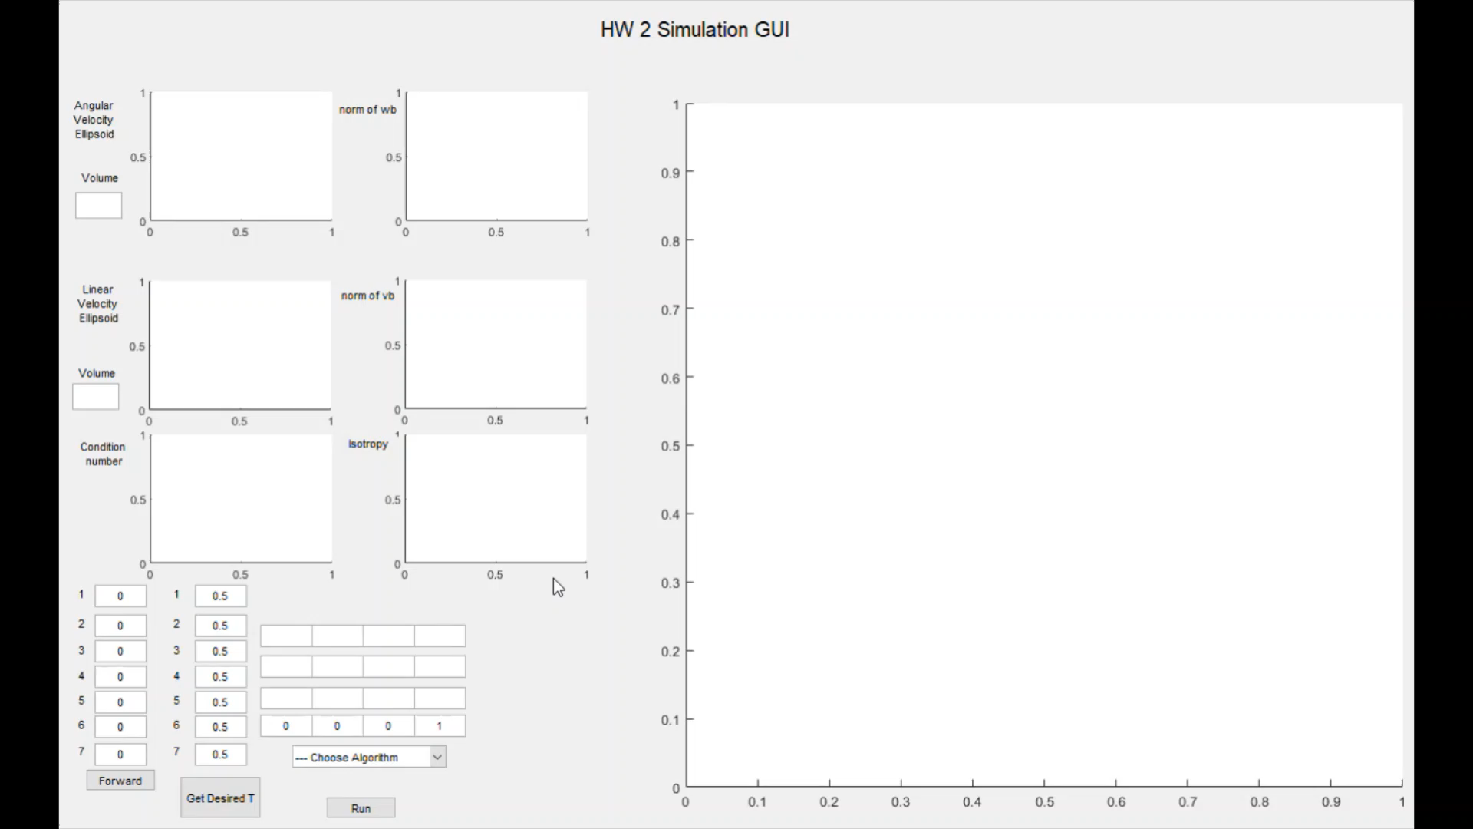
Results of PA1.h
Output2: inverse kinematics algorithm

Slide 6
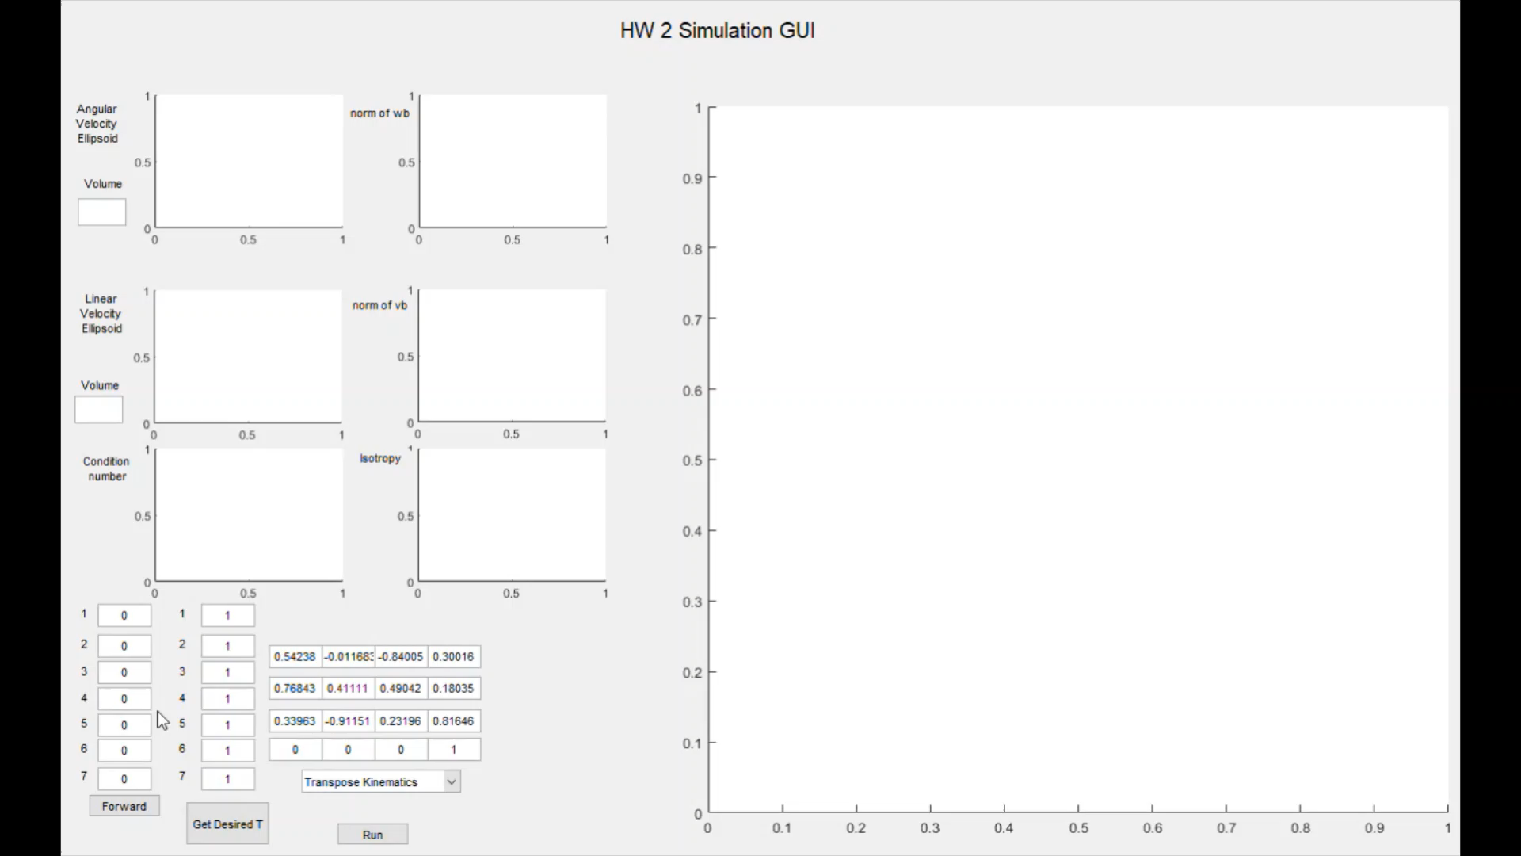
Results of PA1.i
Output1:jacobian transpose algorithm

Slide 7
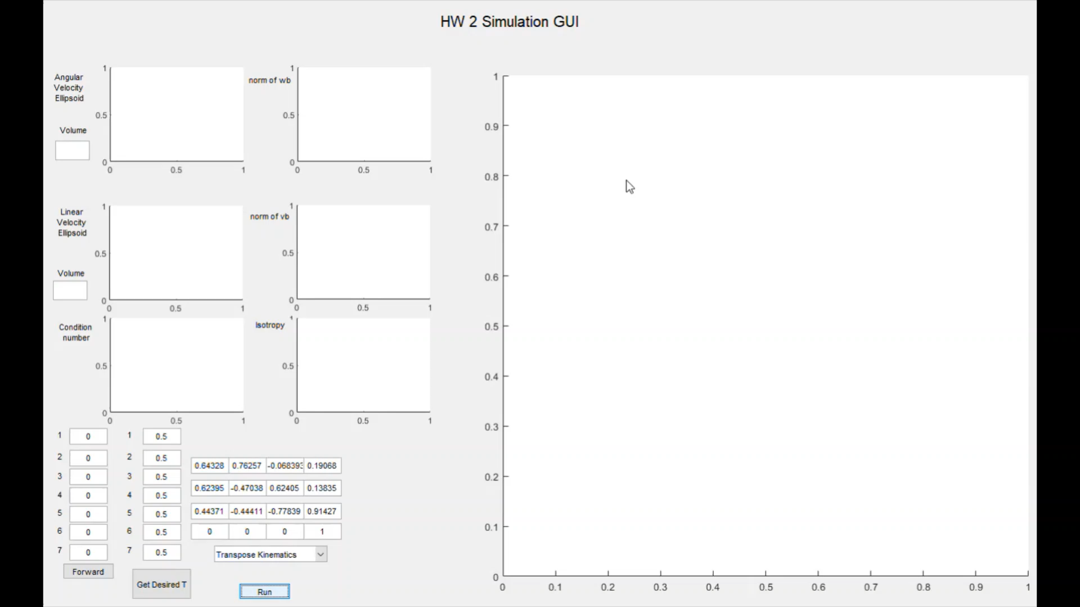
Results of PA1.i
Output2:jacobian transpose algorithm

Slide 8
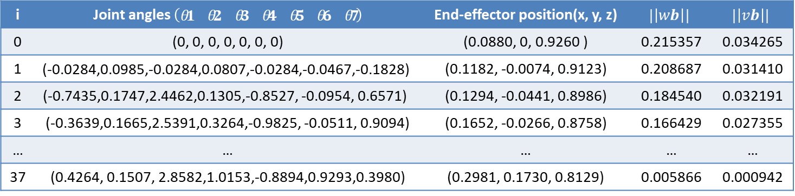
Results of PA1.h
Output1:inverse kinematics algorithm
i | Joint angles $\left(\begin{matrix}θ1 & θ2 & θ3 & θ4 & θ5 & θ6 & θ7\end{matrix}\right)$ | End-effector position(x, y, z) | $$|\left|wb\right||$$ | $$|\left|vb\right||$$
0 | (0, 0, 0, 0, 0, 0, 0) | (0.0880, 0, 0.9260 ) | 0.215357 | 0.034265
1 | $$\text{(−0.0284,0.0985,−0.0284,0.0807,−0.0284,−0.0467,−0.1828)}$$ | (0.1182, -0.0074, 0.9123) | 0.208687 | 0.031410
2 | (-0.7435,0.1747,2.4462,0.1305,-0.8527, -0.0954, 0.6571) | (0.1294, -0.0441, 0.8986) | 0.184540 | 0.032191
3 | (-0.3639,0.1665,2.5391,0.3264,-0.9825, -0.0511, 0.9094) | (0.1652, -0.0266, 0.8758) | 0.166429 | 0.027355
… | … | … | … | …
37 | (0.4264, 0.1507, 2.8582,1.0153,-0.8894,0.9293,0.3980) | (0.2981, 0.1730, 0.8129) | 0.005866 | 0.000942
Final configuration after 37 iterations: end-effector position: (x; y; z) = [0.2981; 0.1730; 0.8129 ];
Desired configuration: end-effector position: (x; y; z) = [0.3002; 0.1803; 0.8165 ];
Final error measure after 37 iterations: $εw$=0.005866; $εv$=0.000942; Error tolerance: $εw$=0.01; $εv$=0.001;

Slide 9
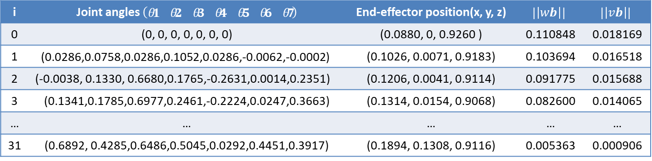
Results of PA1.h
Output2:inverse kinematics algorithm
i | Joint angles $\left(\begin{matrix}θ1 & θ2 & θ3 & θ4 & θ5 & θ6 & θ7\end{matrix}\right)$ | End-effector position(x, y, z) | $$|\left|wb\right||$$ | $$|\left|vb\right||$$
0 | (0, 0, 0, 0, 0, 0, 0) | (0.0880, 0, 0.9260 ) | 0.110848 | 0.018169
1 | $$\text{(}\text{0.0286}\text{,}\text{0.0758}\text{,}\text{0.0286}\text{,}\text{0.1052}\text{,}\text{0.0286}\text{,}\text{−0.0062}\text{,}\text{−0.0002)}$$ | (0.1026, 0.0071, 0.9183) | 0.103694 | 0.016518
2 | (-0.0038, 0.1330, 0.6680,0.1765,-0.2631,0.0014,0.2351) | (0.1206, 0.0041, 0.9114) | 0.091775 | 0.015688
3 | (0.1341,0.1785,0.6977,0.2461,-0.2224,0.0247,0.3663) | (0.1314, 0.0154, 0.9068) | 0.082600 | 0.014065
… | … | … | … | …
31 | (0.6892, 0.4285,0.6486,0.5045,0.0292,0.4451,0.3917) | (0.1894, 0.1308, 0.9116) | 0.005363 | 0.000906
Final configuration after 31 iterations: end-effector position: (x; y; z) = [0.1894; 0.1308; 0.9116 ];
Desired configuration: end-effector position: (x; y; z) = [0.1907; 0.1383; 0.9143 ];
Final error measure after 31 iterations: $εw$= 0.005363; $εv$= 0.000906; Error tolerance: $εw$=0.01; $εv$=0.001;

Slide 10

Results of PA1.i
Output1:jacobian transpose algorithm
i | Joint angles $\left(\begin{matrix}θ1 & θ2 & θ3 & θ4 & θ5 & θ6 & θ7\end{matrix}\right)$ | End-effector position(x, y, z) | $$|\left|wb\right||$$ | $$|\left|vb\right||$$
0 | (0, 0, 0, 0, 0, 0, 0) | (0.0880, 0, 0.9260 ) | 0.215357 | 0.034265
1 | $$\text{(}\text{0.0257}\text{, }\text{0.0223}\text{, }\text{0.0257}\text{, }\text{−0.0194}\text{,}\text{0.0257}\text{,}\text{−0.0165}\text{,}\text{−0.0259}\text{)}$$ | (0.1044, 0.0072, 0.9223) | 0.209076 | 0.031775
2 | (0.0482, 0.0444, 0.0493,-0.0376 ,0.0502,-0.0308,-0.0513) | (0.1201, 0.0147, 0.9183) | 0.203421 | 0.029465
3 | (0.0678, 0.0666, 0.0710, -0.0549,0.0737,-0.0431,-0.0765) | (0.1352, 0.0223, 0.9141) | 0.198276 | 0.027297
… | … | … | … | …
139 | (-0.1790, -0.3675, 0.2642, -1.8915, 2.1028,0.6522,0.0185) | (0.3024, 0.1826, 0.8081) | 0.000293 | 0.000925
Final configuration after 139 iterations: end-effector position: (x; y; z) = [0.3024; 0.1826; 0.8081 ];
Desired configuration: end-effector position: (x; y; z) = [0.3002; 0.1803; 0.8165 ];
Final error measure after 139 iterations: $εw$=0.000293; $εv$=0.000925; Error tolerance: $εw$=0.01; $εv$=0.001;

Slide 11
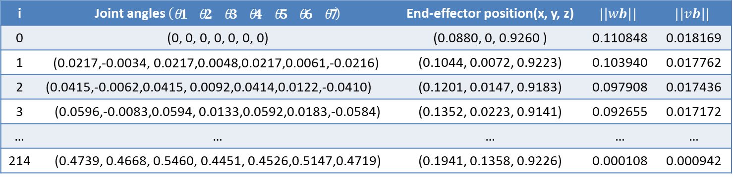
Results of PA1.i
Output2:jacobian transpose algorithm
i | Joint angles $\left(\begin{matrix}θ1 & θ2 & θ3 & θ4 & θ5 & θ6 & θ7\end{matrix}\right)$ | End-effector position(x, y, z) | $$|\left|wb\right||$$ | $$|\left|vb\right||$$
0 | (0, 0, 0, 0, 0, 0, 0) | (0.0880, 0, 0.9260 ) | 0.110848 | 0.018169
1 | $$\text{(}\text{0.0217}\text{,}\text{−0.0034}\text{,}\text{ 0.0217}\text{,}\text{0.0048}\text{,}\text{0.0217}\text{,}\text{0.0061}\text{,}\text{−0.0216}\text{)}$$ | (0.1044, 0.0072, 0.9223) | 0.103940 | 0.017762
2 | (0.0415,-0.0062,0.0415, 0.0092,0.0414,0.0122,-0.0410) | (0.1201, 0.0147, 0.9183) | 0.097908 | 0.017436
3 | (0.0596,-0.0083,0.0594, 0.0133,0.0592,0.0183,-0.0584) | (0.1352, 0.0223, 0.9141) | 0.092655 | 0.017172
… | … | … | … | …
214 | (0.4739, 0.4668, 0.5460, 0.4451, 0.4526,0.5147,0.4719) | (0.1941, 0.1358, 0.9226) | 0.000108 | 0.000942
Final configuration after 214 iterations: end-effector position: (x; y; z) = [0.1941; 0.1358; 0.9226 ];
Desired configuration: end-effector position: (x; y; z) = [0.1907; 0.1383; 0.9143 ];
Final error measure after 214 iterations: $εw$= 0.000108; $εv$= 0.000942; Error tolerance: $εw$=0.01; $εv$=0.001;

Slide 12
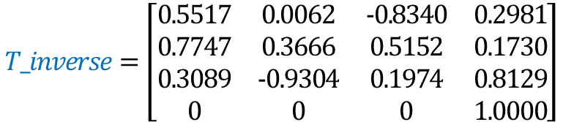

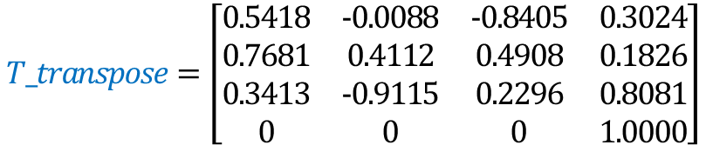
Brief comparison between PA1.h and PA1.i
Result comparison 1
$$b=\left[\begin{matrix}0.5424 & −0.0117 & −0.8401 & 0.3002 \\ 0.7684 & 0.4111 & 0.4904 & 0.1803 \\ 0.3396 & −0.9115 & 0.2320 & 0.8165 \\ 0 & 0 & 0 & 1.0000\end{matrix}\right]$$
Desired configuration:
$$T_inverse=\left[\begin{matrix}0.5517 & 0.0062 & −0.8340 & 0.2981 \\ 0.7747 & 0.3666 & 0.5152 & 0.1730 \\ 0.3089 & −0.9304 & 0.1974 & 0.8129 \\ 0 & 0 & 0 & 1.0000\end{matrix}\right]$$
Final configuration after 37 iterations by
using inverse kinematics algorithm
$$T_transpose=\left[\begin{matrix}0.5418 & −0.0088 & −0.8405 & 0.3024 \\ 0.7681 & 0.4112 & 0.4908 & 0.1826 \\ 0.3413 & −0.9115 & 0.2296 & 0.8081 \\ 0 & 0 & 0 & 1.0000\end{matrix}\right]$$
Final configuration after 139 iterations by
using jacobian transpose algorithm
Results analysis: 1. Final error measure is smaller than the desired error tolerance. 2. Robot can reach the desired configuration. 3. The convergence process is different. 4. The inverse kinematics algorithm converges faster than jacobian transpose algorithm.

Slide 13
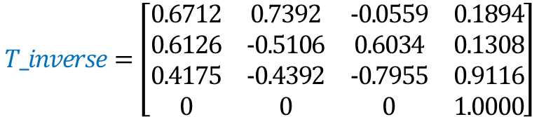

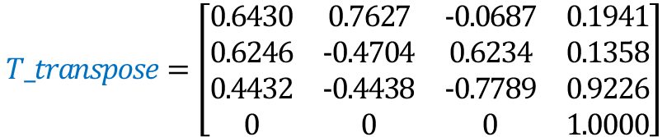
Brief comparison between PA1.h and PA1.i
Result comparison 2
$$b=\left[\begin{matrix}0.6433 & 0.7626 & −0.0684 & 0.1907 \\ 0.6240 & −0.4704 & 0.6240 & 0.1383 \\ 0.4437 & −0.4441 & −0.7784 & 0.9143 \\ 0 & 0 & 0 & 1.0000\end{matrix}\right]$$
Desired configuration:
$$T_inverse=\left[\begin{matrix}0.6712 & 0.7392 & −0.0559 & 0.1894 \\ 0.6126 & −0.5106 & 0.6034 & 0.1308 \\ 0.4175 & −0.4392 & −0.7955 & 0.9116 \\ 0 & 0 & 0 & 1.0000\end{matrix}\right]$$
Final configuration after 31 iterations by
using inverse kinematics algorithm
$$T_transpose=\left[\begin{matrix}0.6430 & 0.7627 & −0.0687 & 0.1941 \\ 0.6246 & −0.4704 & 0.6234 & 0.1358 \\ 0.4432 & −0.4438 & −0.7789 & 0.9226 \\ 0 & 0 & 0 & 1.0000\end{matrix}\right]$$
Final configuration after 214 iterations by
using jacobian transpose algorithm
Results analysis: 1. Final error measure is smaller than the desired error tolerance. 2. Robot can reach the desired configuration. 3. The convergence process is different. 4. The inverse kinematics algorithm converges faster than jacobian transpose algorithm.

Slide 14
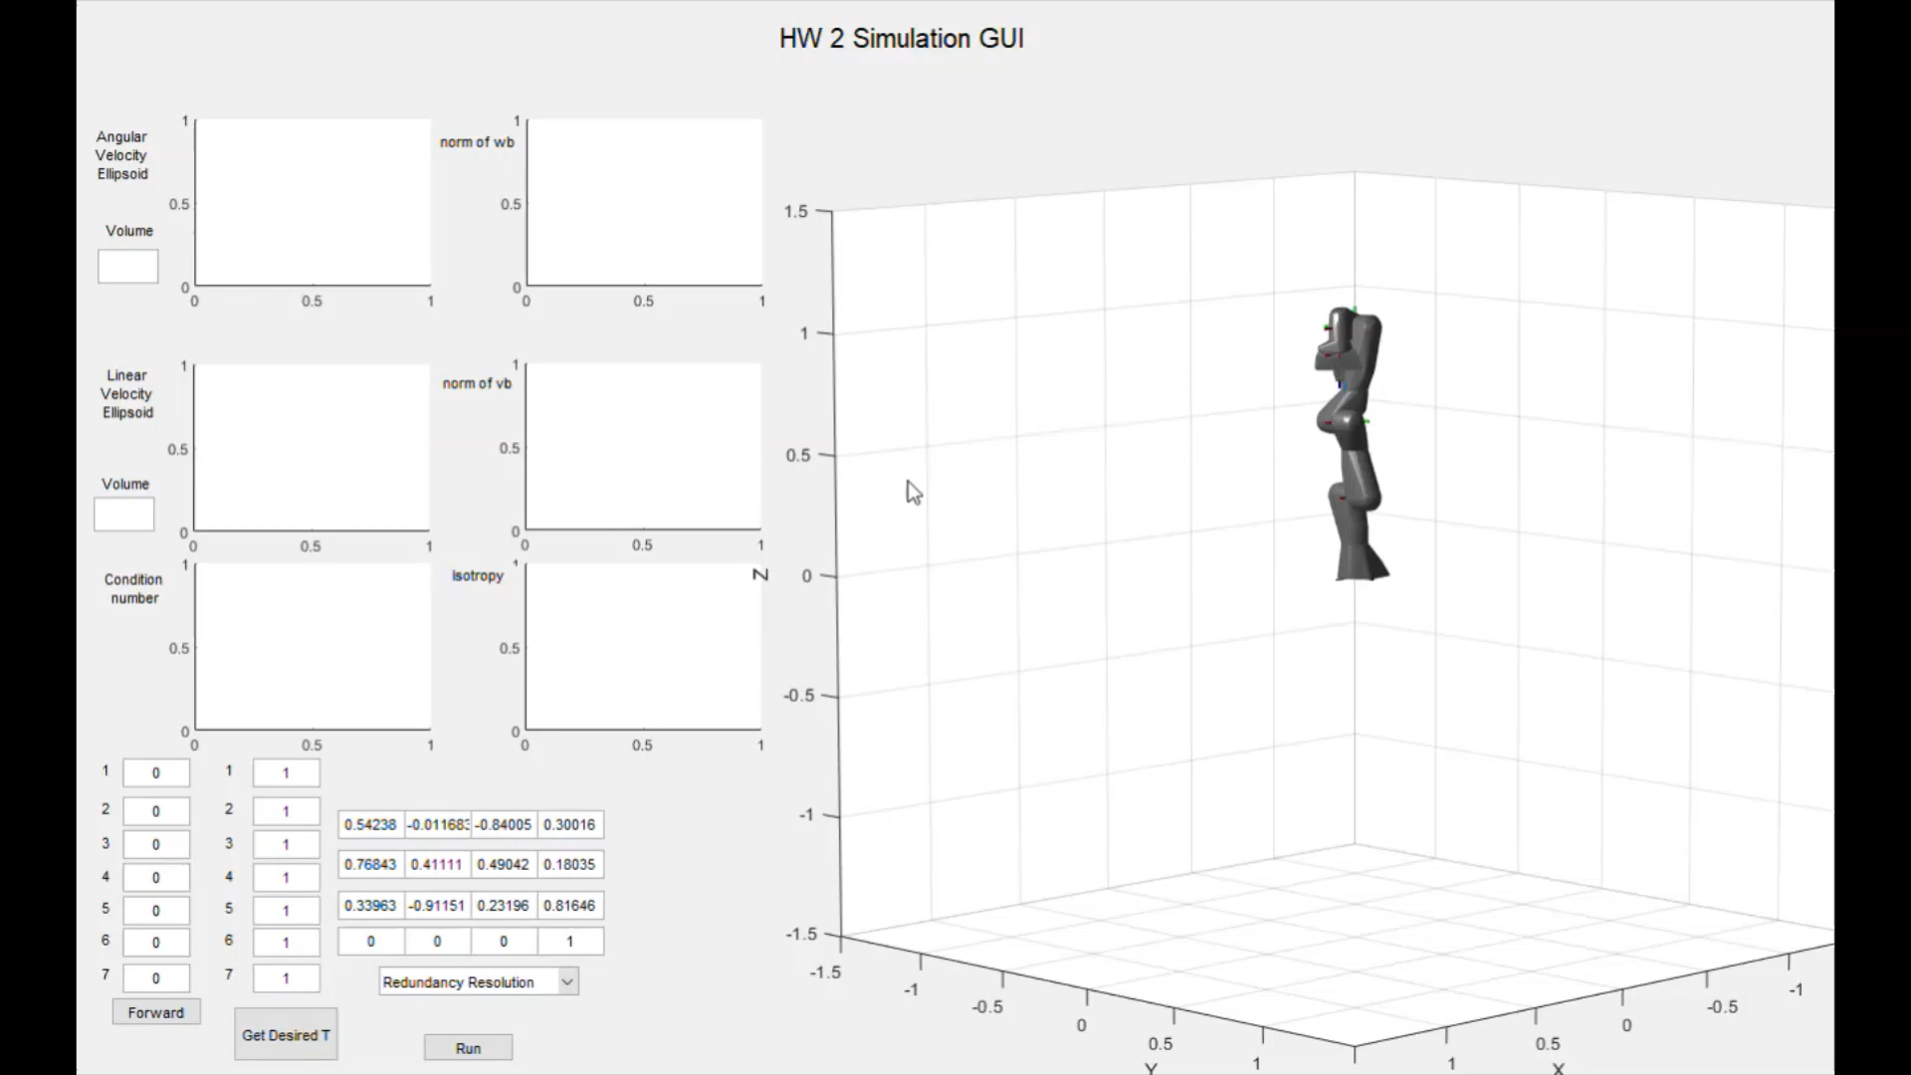
Results of PA1.j
Output1: redundancy resolution algorithm

Slide 15
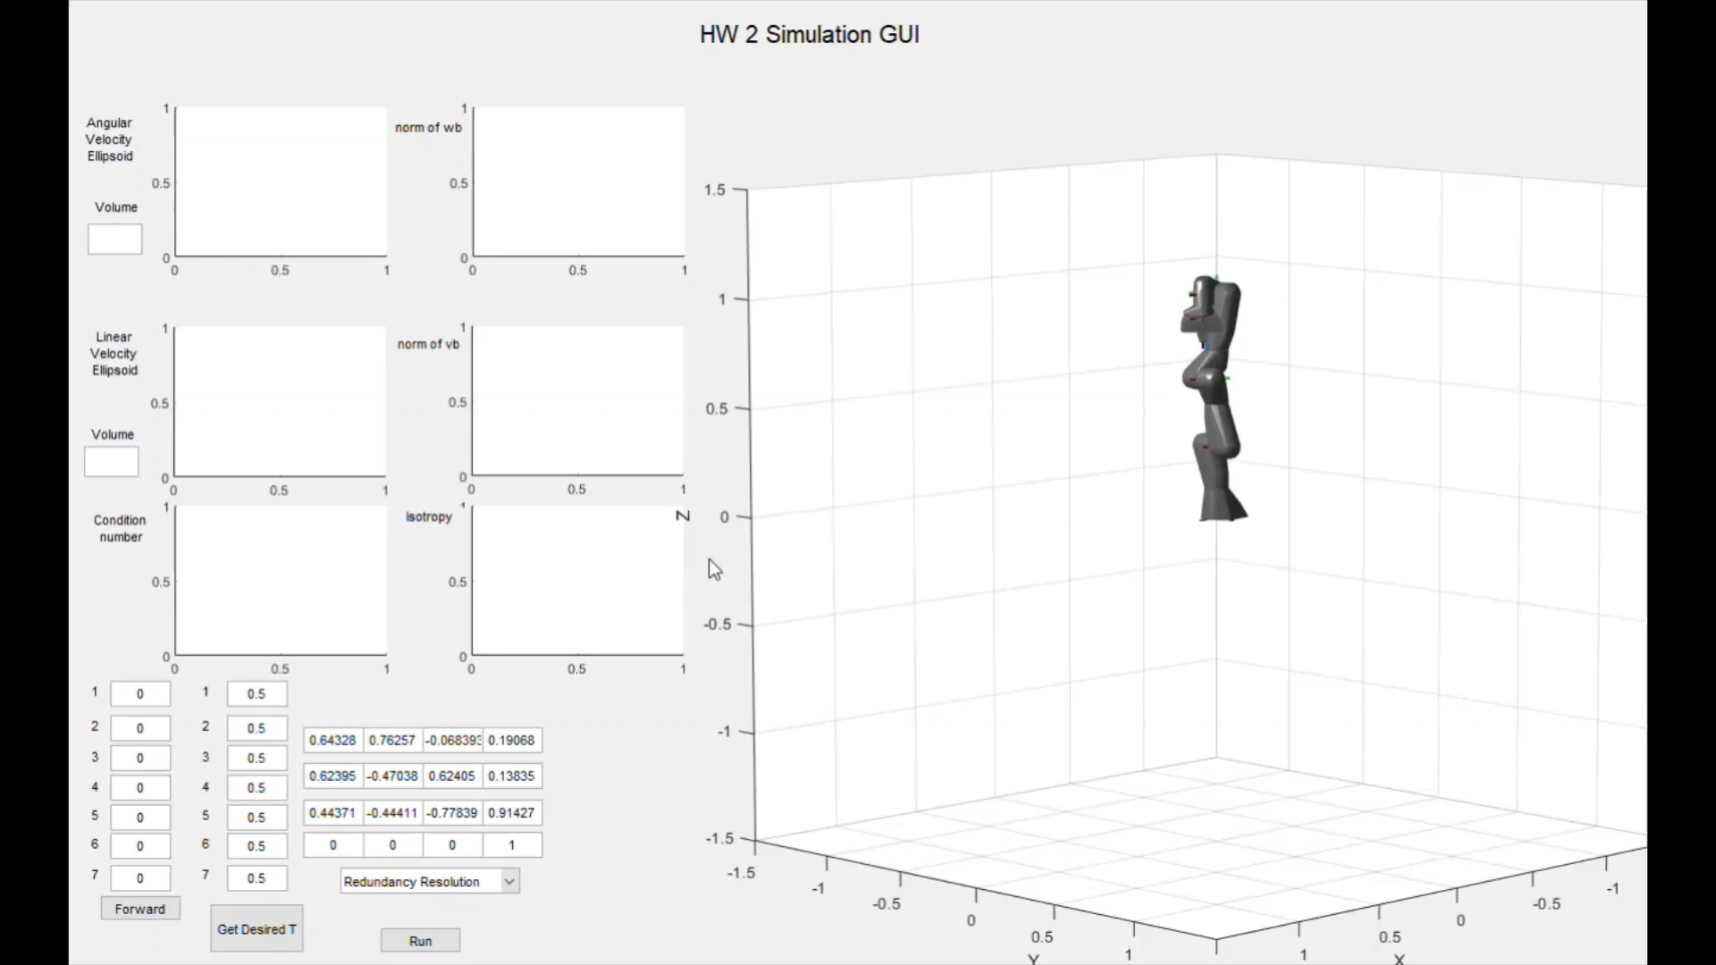
Results of PA1.j
Output2: redundancy resolution algorithm

Slide 16
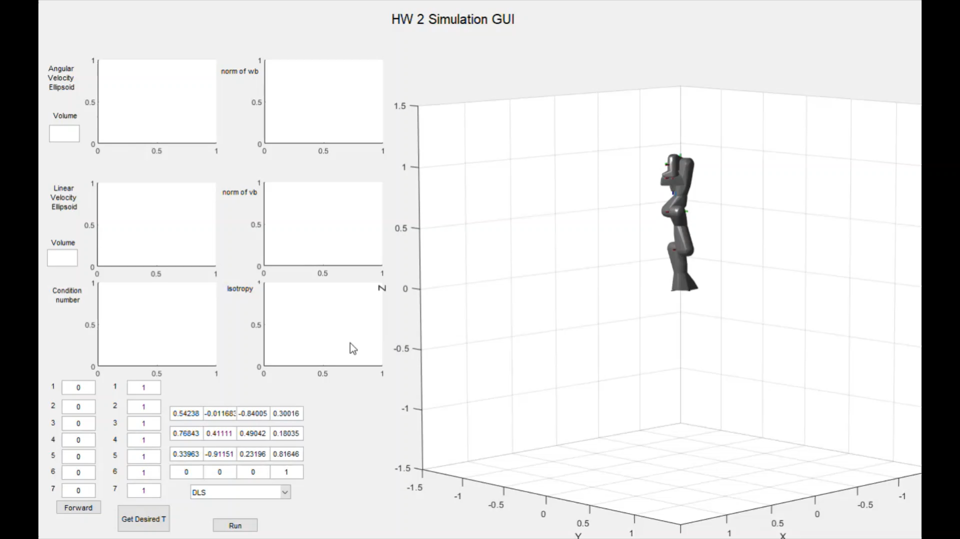
Results of PA1.k
Output1: DLS inverse kinematics algorithm

Slide 17
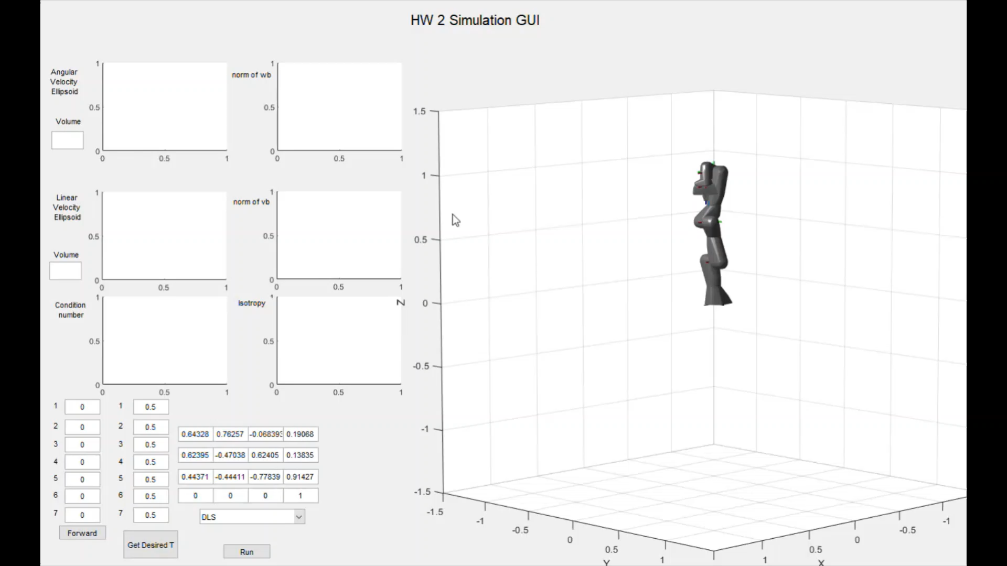
Results of PA1.k
Output2: DLS inverse kinematics algorithm

Slide 18
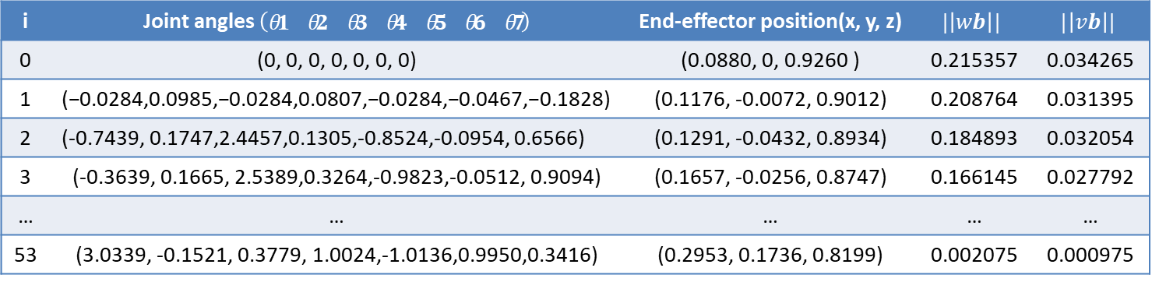
Results of PA1.j
Output1: redundancy resolution algorithm
i | Joint angles $\left(\begin{matrix}θ1 & θ2 & θ3 & θ4 & θ5 & θ6 & θ7\end{matrix}\right)$ | End-effector position(x, y, z) | $$|\left|wb\right||$$ | $$|\left|vb\right||$$
0 | (0, 0, 0, 0, 0, 0, 0) | (0.0880, 0, 0.9260 ) | 0.215357 | 0.034265
1 | $$\text{(−0.0284,0.0985,−0.0284,0.0807}\text{,}\text{−0.0284,−0.0467,−0.1828)}$$ | (0.1176, -0.0072, 0.9012) | 0.208764 | 0.031395
2 | (-0.7439, 0.1747,2.4457,0.1305,-0.8524,-0.0954, 0.6566) | (0.1291, -0.0432, 0.8934) | 0.184893 | 0.032054
3 | (-0.3639, 0.1665, 2.5389,0.3264,-0.9823,-0.0512, 0.9094) | (0.1657, -0.0256, 0.8747) | 0.166145 | 0.027792
… | … | … | … | …
53 | (3.0339, -0.1521, 0.3779, 1.0024,-1.0136,0.9950,0.3416) | (0.2953, 0.1736, 0.8199) | 0.002075 | 0.000975
Final configuration after 53 iterations: end-effector position: (x; y; z) = [0.2953; 0.1736; 0.8199 ];
Desired configuration: end-effector position: (x; y; z) = [0.3002; 0.1803; 0.8165 ];
Final error measure after 53 iterations: $εw$= 0.002075; $εv$= 0.000975; Error tolerance: $εw$=0.01; $εv$=0.001;

Slide 19
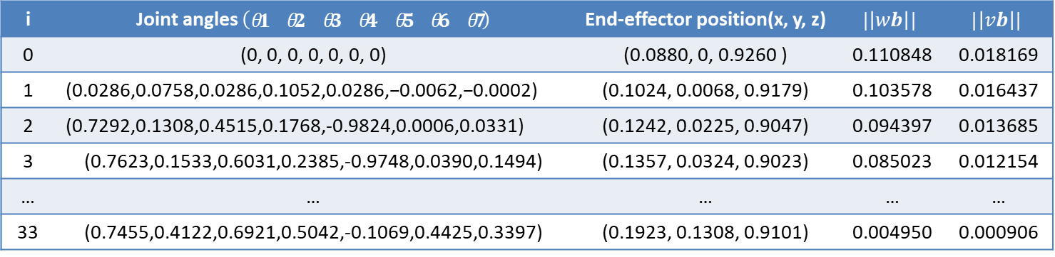
Results of PA1.j
Output2: redundancy resolution algorithm
i | Joint angles $\left(\begin{matrix}θ1 & θ2 & θ3 & θ4 & θ5 & θ6 & θ7\end{matrix}\right)$ | End-effector position(x, y, z) | $$|\left|wb\right||$$ | $$|\left|vb\right||$$
0 | (0, 0, 0, 0, 0, 0, 0) | (0.0880, 0, 0.9260 ) | 0.110848 | 0.018169
1 | $$\text{(}\text{0.0286}\text{,}\text{0.0758}\text{,}\text{0.0286}\text{,}\text{0.1052}\text{,}\text{0.0286}\text{,}\text{−0.0062}\text{,}\text{−0.0002)}$$ | (0.1024, 0.0068, 0.9179) | 0.103578 | 0.016437
2 | (0.7292,0.1308,0.4515,0.1768,-0.9824,0.0006,0.0331) | (0.1242, 0.0225, 0.9047) | 0.094397 | 0.013685
3 | (0.7623,0.1533,0.6031,0.2385,-0.9748,0.0390,0.1494) | (0.1357, 0.0324, 0.9023) | 0.085023 | 0.012154
… | … | … | … | …
33 | (0.7455,0.4122,0.6921,0.5042,-0.1069,0.4425,0.3397) | (0.1923, 0.1308, 0.9101) | 0.004950 | 0.000906
Final configuration after 33 iterations: end-effector position: (x; y; z) = [0.1923; 0.1308; 0.9101 ];
Desired configuration: end-effector position: (x; y; z) = [0.1907; 0.1383; 0.9143 ];
Final error measure after 33 iterations: $εw$= 0.004950; $εv$= 0.000906; Error tolerance: $εw$=0.01; $εv$=0.001;

Slide 20
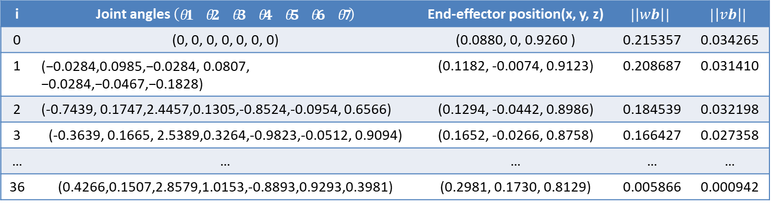
Results of PA1.k
Output1: DLS inverse kinematics algorithm
i | Joint angles $\left(\begin{matrix}θ1 & θ2 & θ3 & θ4 & θ5 & θ6 & θ7\end{matrix}\right)$ | End-effector position(x, y, z) | $$|\left|wb\right||$$ | $$|\left|vb\right||$$
0 | (0, 0, 0, 0, 0, 0, 0) | (0.0880, 0, 0.9260 ) | 0.215357 | 0.034265
1 | $$\text{(−0.0284,0.0985,−0.0284, 0.0807}\text{,} \text{−0.0284,−0.0467,−0.1828)}$$ | (0.1182, -0.0074, 0.9123) | 0.208687 | 0.031410
2 | (-0.7439, 0.1747,2.4457,0.1305,-0.8524,-0.0954, 0.6566) | (0.1294, -0.0442, 0.8986) | 0.184539 | 0.032198
3 | (-0.3639, 0.1665, 2.5389,0.3264,-0.9823,-0.0512, 0.9094) | (0.1652, -0.0266, 0.8758) | 0.166427 | 0.027358
… | … | … | … | …
36 | (0.4266,0.1507,2.8579,1.0153,-0.8893,0.9293,0.3981) | (0.2981, 0.1730, 0.8129) | 0.005866 | 0.000942
Final configuration after 36 iterations: end-effector position: (x; y; z) = [0.2981; 0.1730; 0.8129 ];
Desired configuration: end-effector position: (x; y; z) = [0.3002; 0.1803; 0.8165 ];
Final error measure after 36 iterations: $εw$= 0.005866; $εv$= 0.000942; Error tolerance: $εw$=0.01; $εv$=0.001;

Slide 21
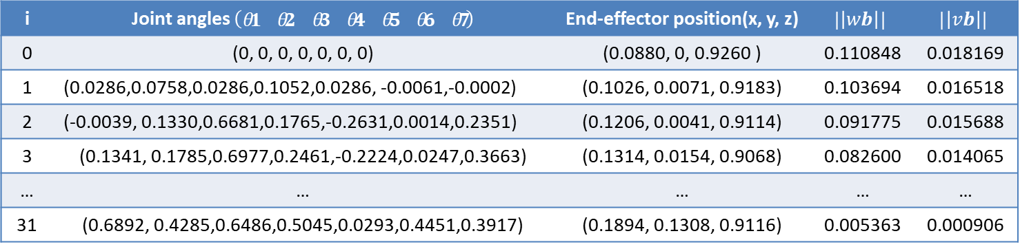
Results of PA1.k
Output2: DLS inverse kinematics algorithm
i | Joint angles $\left(\begin{matrix}θ1 & θ2 & θ3 & θ4 & θ5 & θ6 & θ7\end{matrix}\right)$ | End-effector position(x, y, z) | $$|\left|wb\right||$$ | $$|\left|vb\right||$$
0 | (0, 0, 0, 0, 0, 0, 0) | (0.0880, 0, 0.9260 ) | 0.110848 | 0.018169
1 | $$\text{(}\text{0.0286}\text{,}\text{0.0758}\text{,}\text{0.0286}\text{,}\text{0.1052}\text{,}\text{0.0286}\text{,}\text{ −0.0061}\text{,}\text{−0.0002)}$$ | (0.1026, 0.0071, 0.9183) | 0.103694 | 0.016518
2 | (-0.0039, 0.1330,0.6681,0.1765,-0.2631,0.0014,0.2351) | (0.1206, 0.0041, 0.9114) | 0.091775 | 0.015688
3 | (0.1341, 0.1785,0.6977,0.2461,-0.2224,0.0247,0.3663) | (0.1314, 0.0154, 0.9068) | 0.082600 | 0.014065
… | … | … | … | …
31 | (0.6892, 0.4285,0.6486,0.5045,0.0293,0.4451,0.3917) | (0.1894, 0.1308, 0.9116) | 0.005363 | 0.000906
Final configuration after 31 iterations: end-effector position: (x; y; z) = [0.1894; 0.1308; 0.9116 ];
Desired configuration: end-effector position: (x; y; z) = [0.1907; 0.1383; 0.9143 ];
Final error measure after 31 iterations: $εw$= 0.005363; $εv$= 0.000906; Error tolerance: $εw$=0.01; $εv$=0.001;

Slide 22
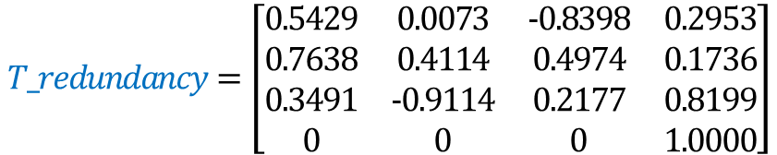

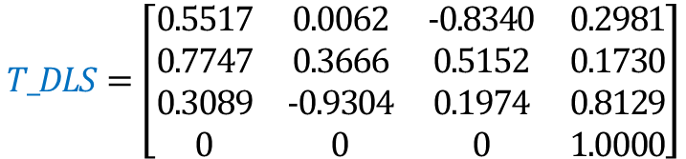
Brief comparison between PA1.j and PA1.k
Result comparison 1
$$b=\left[\begin{matrix}0.5424 & −0.0117 & −0.8401 & 0.3002 \\ 0.7684 & 0.4111 & 0.4904 & 0.1803 \\ 0.3396 & −0.9115 & 0.2320 & 0.8165 \\ 0 & 0 & 0 & 1.0000\end{matrix}\right]$$
Desired configuration:
$$T_redundancy=\left[\begin{matrix}0.5429 & 0.0073 & −0.8398 & 0.2953 \\ 0.7638 & 0.4114 & 0.4974 & 0.1736 \\ 0.3491 & −0.9114 & 0.2177 & 0.8199 \\ 0 & 0 & 0 & 1.0000\end{matrix}\right]$$
Final configuration after 53 iterations by
using inverse kinematics algorithm
$$T_DLS=\left[\begin{matrix}0.5517 & 0.0062 & −0.8340 & 0.2981 \\ 0.7747 & 0.3666 & 0.5152 & 0.1730 \\ 0.3089 & −0.9304 & 0.1974 & 0.8129 \\ 0 & 0 & 0 & 1.0000\end{matrix}\right]$$
Final configuration after 36 iterations by
using DLS inverse kinematics algorithm
Results analysis: 1. Final error measure is smaller than the desired error tolerance. 2. Robot can reach the desired configuration. 3. The convergence process is different. 4. Singularity can be detected by evaluating the volume of the manipulability ellipsoid. 5. Singularity can be avoided by using redundancy.

Slide 23

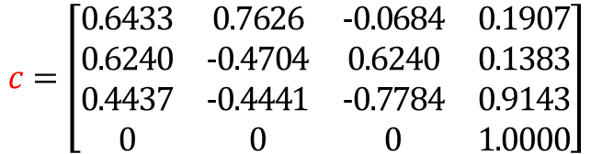
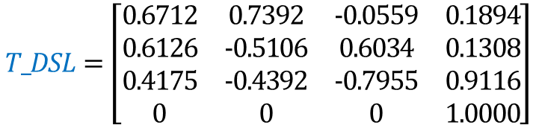
Brief comparison between PA1.j and PA1.k
Result comparison 2
$$c=\left[\begin{matrix}0.6433 & 0.7626 & −0.0684 & 0.1907 \\ 0.6240 & −0.4704 & 0.6240 & 0.1383 \\ 0.4437 & −0.4441 & −0.7784 & 0.9143 \\ 0 & 0 & 0 & 1.0000\end{matrix}\right]$$
Desired configuration:
$$T_redundancy=\left[\begin{matrix}0.6654 & 0.7441 & −0.0597 & 0.1923 \\ 0.6197 & −0.5060 & 0.5999 & 0.1308 \\ 0.4162 & −0.4362 & −0.7978 & 0.9101 \\ 0 & 0 & 0 & 1.0000\end{matrix}\right]$$
Final configuration after 33 iterations by
using redundancy resolution algorithm
$$T_DSL=\left[\begin{matrix}0.6712 & 0.7392 & −0.0559 & 0.1894 \\ 0.6126 & −0.5106 & 0.6034 & 0.1308 \\ 0.4175 & −0.4392 & −0.7955 & 0.9116 \\ 0 & 0 & 0 & 1.0000\end{matrix}\right]$$
Final configuration after 31 iterations by
using DLS inverse kinematics algorithm
Results analysis: 1. Final error measure is smaller than the desired error tolerance. 2. Robot can reach the desired configuration. 3. The convergence process is different. 4. Singularity can be detected by evaluating the volume of the manipulability ellipsoid. 5. Singularity can be avoided by using redundancy.

Slide 24
Challenges we experienced and lessons we learnt
Challenges
When the target positions are too distant, the robot will stretch out to reach to target position. In such configuration that is near singularity (jacobian is very sensitive to small changes of joint angles ), oscillation will happen.
We do not consider any aspects of joint limits or avoiding self-collisions.
Lessons we learnt
When a robot is near singularity configuration, we can use redundant resolution to generate internal motion. It does not change the end-effector position and orientation but may allow manipulator reconfiguration.
We can use manipulability measure as an objective function. By maximizing this measure, redundancy can be used to move away from singularity.

